Slide 1
Our Color Vision is Limited (Chapter 5) Lecture 11-12

Slide 2
Introduction
How the human visual system (Sense of Sight) processes color information and perceive colors
What is significance of understanding qualities of human color vision and are factors affecting color perception
Our vision is optimized to detect contrasts (edges), not absolute brightness
Our ability to distinguish colors depends on how colors are presented
Display technologies/resolution and viewing conditions
Some people may have color-blindness
External factors such as sunlight, ambient light

Slide 3
Color Vision
Human eye – light receptor cells
Rods
Rods deals with low light vision (Night Light/Darkness)
Rods are sensitive to overall brightness exists in low light vision
Cones
Cones deals with color vision i.e. high light vision (Day Light)
Cones are sensitive to different types of colors
Red, Green, and Blue
Three types of cones i.e. sensitive to a wide range of different colors based on light frequency
Low frequency cones – yellow and red
Medium frequency cones – blue and orange
High frequency cones – violet and blue

Slide 4

Edge Contrast [1/2]
Figure Source: Designing with the Mind in Mind, J. Johnson, 2nd Ed. P. 55

Slide 5
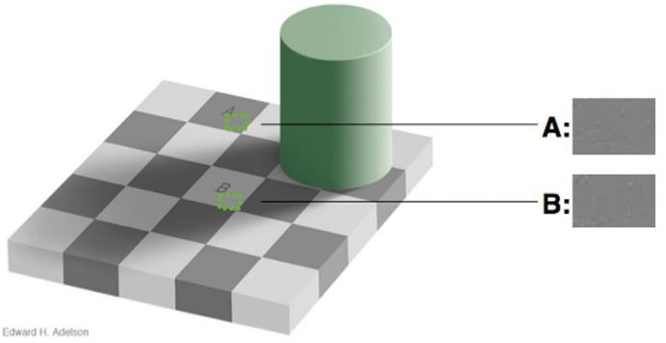
Edge Contrast [2/2]
Figure Source: Designing with the Mind in Mind, J. Johnson, 2nd Ed. P. 56

Slide 6
Ability to Discriminate Colors [1/6]
Depends on color presentation
Paleness
Less saturated
Color patch size
Thin objects
Separation
Distant objects

Slide 7

Ability to Discriminate Colors [2/6]
Figure Source: Designing with the Mind in Mind, J. Johnson, 2nd Ed. P. 57

Slide 8

Ability to Discriminate Colors [3/6]
Figure Source: Designing with the Mind in Mind, J. Johnson, 2nd Ed. P. 57

Slide 9
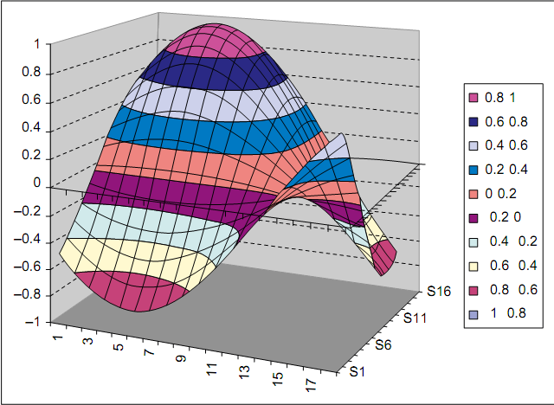
Ability to Discriminate Colors [4/6]
Figure Source: Designing with the Mind in Mind, J. Johnson, 2nd Ed. P. 57

Slide 10
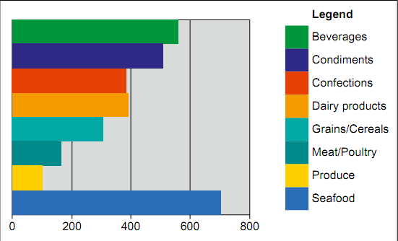
Ability to Discriminate Colors [5/6]
Figure Source: Designing with the Mind in Mind, J. Johnson, 2nd Ed. P. 58

Slide 11
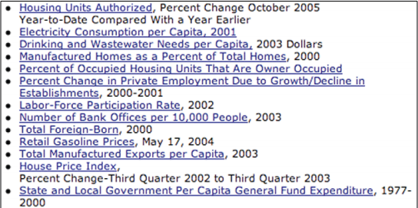
Ability to Discriminate Colors [6/6]
Figure Source: Designing with the Mind in Mind, J. Johnson, 2nd Ed. P. 58

Slide 12
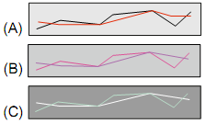
Color Blindness [1/3]
Vision deficit/deficiency
Difficulty to distinguish colors
8% of men and 0.5% of women have vision deficiency
Most common deficiency – Red/green
Figure Source: Designing with the Mind in Mind, J. Johnson, 2nd Ed. P. 59

Slide 13
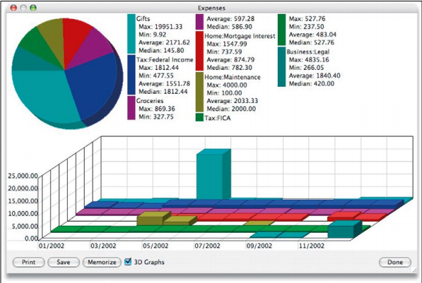
Color Blindness [2/3]
Figure Source: Designing with the Mind in Mind, J. Johnson, 2nd Ed. P. 59

Slide 14
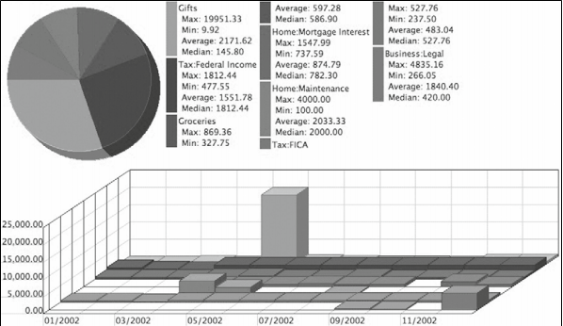
Color Blindness [3/3]
Figure Source: Designing with the Mind in Mind, J. Johnson, 2nd Ed. P. 60

Slide 15
External Factors
Variation among color displays
Technology, software, color setting
Same model may have different colors
Grayscale displays
Difficult to differentiate similar colors
Display angle
LCDs
Ambient illuminations
Strong light

Slide 16
Guidelines for Using Colors [1/7]
Distinguish colors by saturation and brightness as well as hue
Saturation: amount of whiteness in color
Hue: Spectral wavelength of the light
Red: long, Green: medium, Blue: short
High contrast is preferable
Check colors in grayscale

Slide 17

Guidelines for Using Colors [2/7]
Use distinctive colors
Figure Source: Designing with the Mind in Mind, J. Johnson, 2nd Ed. P. 61

Slide 18
Guidelines for Using Colors [3/7]
Avoid color pairs that color-blind people cannot distinguish
Dark red versus black, dark red versus dark green, blue versus purple, light green versus white
Don’t use dark reds, blues, or violets against any dark colors
Use dark reds, blues, and violets against light yellows and greens
Vischeck.com

Slide 19

Guidelines for Using Colors [4/7]
Use color redundantly with other cues
Don’t rely on color alone
Figure Source: Designing with the Mind in Mind, J. Johnson, 2nd Ed. P. 62

Slide 20

Guidelines for Using Colors [5/7]
Separate strong opponent colors
Don’t place opponent colors to next/top each other
Figure Source: Designing with the Mind in Mind, J. Johnson, 2nd Ed. P. 62

Slide 21

Guidelines for Using Colors [6/7]
Figure Source: Designing with the Mind in Mind, J. Johnson, 2nd Ed. P. 63

Slide 22
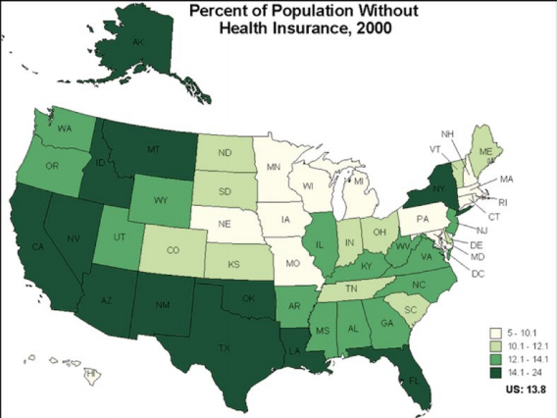
Guidelines for Using Colors [7/7]
Figure Source: Designing with the Mind in Mind, J. Johnson, 2nd Ed. P. 63

